Slide 1



THE ENHANCED SECURITY IN IOT NETWORKS
Submitted by :- GNANESH KUMAR.K(192211352)
MAHENDRA REDDY.M(192210555)
Guided by:- Dr.SELVIN PRADEEPKUMAR
CSA5165-CRYPTOGRAPHY AND NETWORK SECURITY FOR CRYPTO ANALYSIS

Slide 2



Objectives
Ensure Data Confidentiality
Enhance Data Integrity
Strengthen Authentication and Authorization
Implement Secure Communication Channels
Educate and Raise Awareness
Manage Device Identities and Access

Slide 3

Abstract
The rapid growth of IoT devices has revolutionized industries but also introduced security vulnerabilities.
This paper presents an enhanced IoT security framework, integrating lightweight cryptography, robust authentication, and blockchain technology to improve data integrity and transparency.
Simulations and real-world tests show significant improvements in securing data transmission, device authentication, and overall network resilience.

Slide 4

Proliferation of IoT Devices
Security Vulnerabilities
The rapid increase in IoT devices has significantly transformed industries by enabling real-time data collection, analysis, and automation, fostering smart environments and efficient operations.
This growth has also introduced substantial security vulnerabilities, making IoT networks attractive targets for cyber-attacks, potentially leading to data breaches, unauthorized access, and disruption of services.icient operations.
INTRODUCTION
Need for Enhanced Security
Real-Time Anomaly Detection
To mitigate these risks, there is a critical need for enhanced security frameworks that address the unique challenges posed by IoT networks, including resource constraints and diverse device capabilities.
Additionally, machine learning algorithms are employed for real-time anomaly detection, ensuring prompt identification and response to potential security breaches, thereby improving the overall resilience of IoT networks.

Slide 5


What is
the IoT?
The Internet of Things (IoT) is a network of physical objects embedded with sensors, software, and other technologies to connect and exchange data with other devices and systems over the internet. This enables automation, improved efficiency, and enhanced decision-making across various applications.

Slide 6
Connectivity: IoT devices are connected to the internet and often to each other, enabling communication and data exchange.
The Key Characteristics of IoT
Sensors and Data Collection: Devices are equipped with sensors to gather data from their environment, such as temperature, motion, humidity, light, and more.
Automation and Control: IoT systems can automate processes based on the data collected, providing remote control and management capabilities.

Slide 7
This literature review provides a comprehensive and updated examination of IoT security, addressing current challenges such as device vulnerabilities, data protection, and network security, while also exploring emerging technologies like blockchain, edge computing, and AI for threat detection.
Unlike previous studies, it highlights the practical implementation of cryptographic solutions tailored for resource-constrained IoT environments and emphasizes the need for continuous advancements in secure communication protocols and regulatory compliance.
By integrating recent developments and case studies, this review offers a holistic view of IoT security, positioning it as a valuable resource for both academic researchers and industry practitioners.
Literature Review

Slide 8

Cryptography in IoT
Data Encryption
Secure Communication Protocols
Authentication
Integrity Verification
Key Management
Lightweight Cryptography

Slide 9


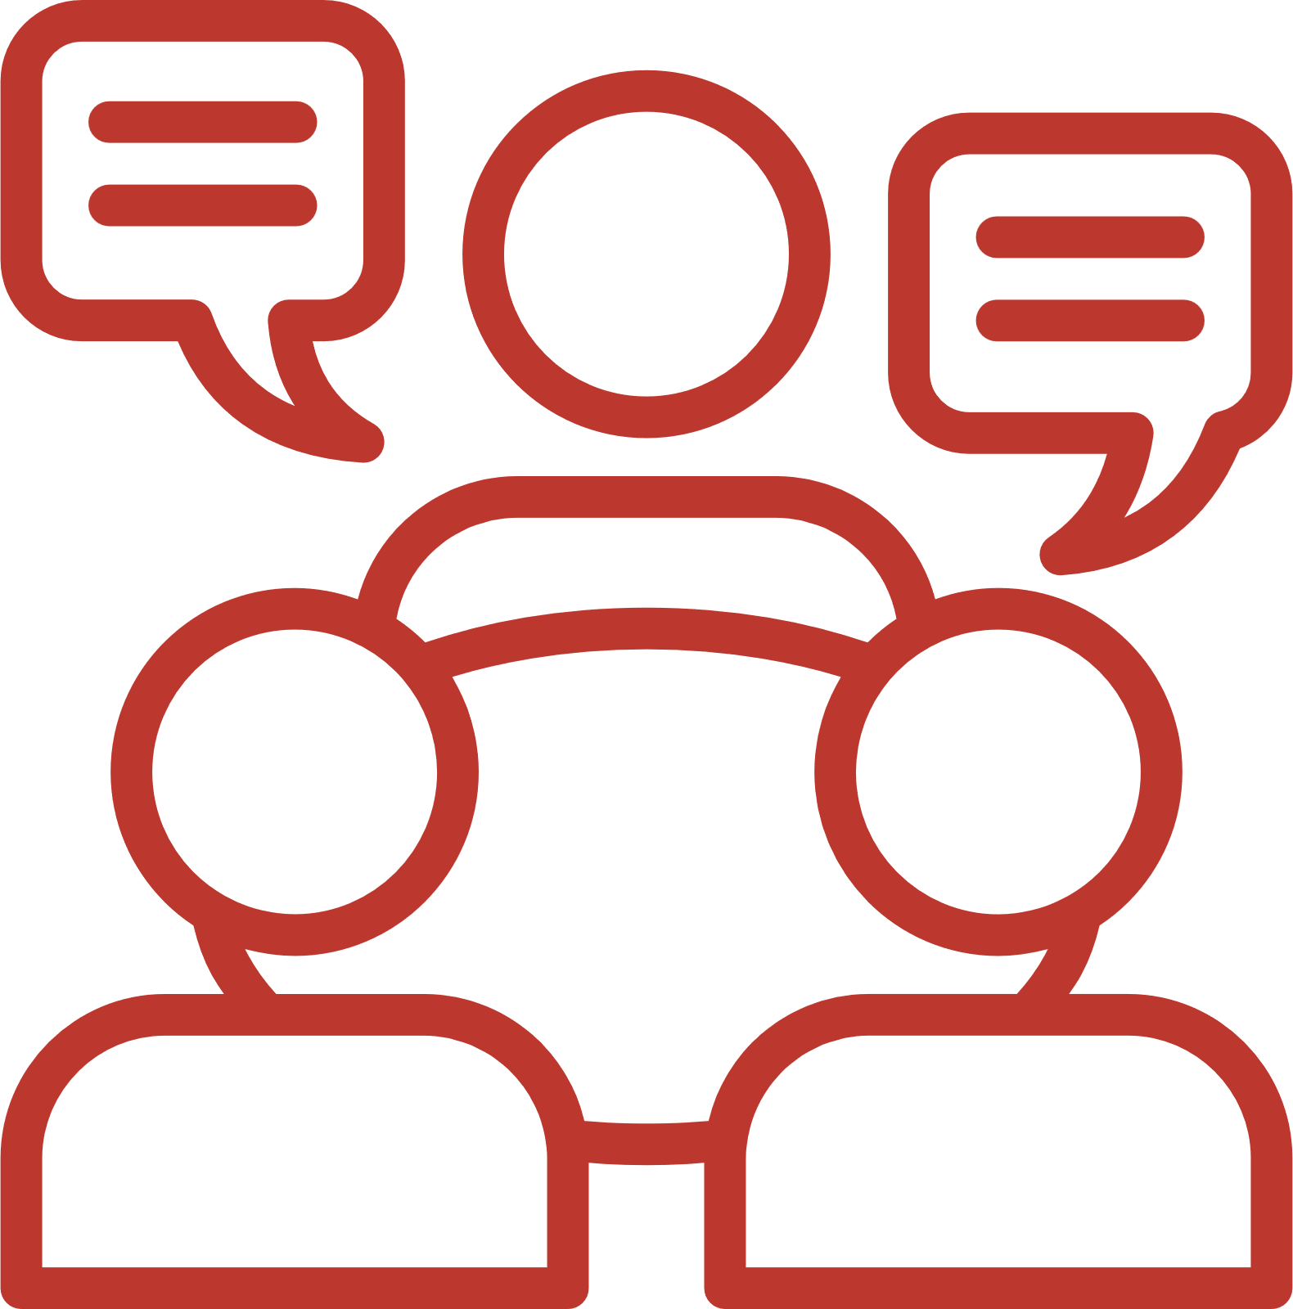





Drawbacks in IoT
Security Vulnerabilities:
Privacy Concerns:
Data Management
Inadequate Security Measures: Many IoT devices lack robust security features, making them susceptible to cyber-attacks.
Data Collection: IoT devices often collect large amounts of personal data, raising concerns about user privacy.
Data Overload: IoT networks generate vast amounts of data, making it challenging to store, manage, and analyze effectively.
Energy Consumption
Cost
Scalability Challenges

Slide 10






How To Secure IoT Network
Use Strong Encryption
Network Segmentation
Strong Authentication
Regular Software Updates
Device Management
Data Privacy

Slide 11
Rivest-Shamir-Adleman (RSA)
Type: Asymmetric Encryption
Description: RSA is a widely used public-key cryptosystem that provides secure data transmission through encryption and decryption. It is particularly useful for secure key distribution and digital signatures but can be computationally intensive for IoT devices with limited resources.
Use Case: Establishing secure communication channels and validating the authenticity of IoT devices.
Digital Signature Algorithm (DSA)
Type: Asymmetric Encryption
Description: DSA is used for digital signatures, ensuring the authenticity and integrity of messages. It is effective in scenarios where verifying the sender's identity is crucial.
Use Case: Validating firmware updates and ensuring the authenticity of commands sent to IoT devices.
Algorithm

Slide 12
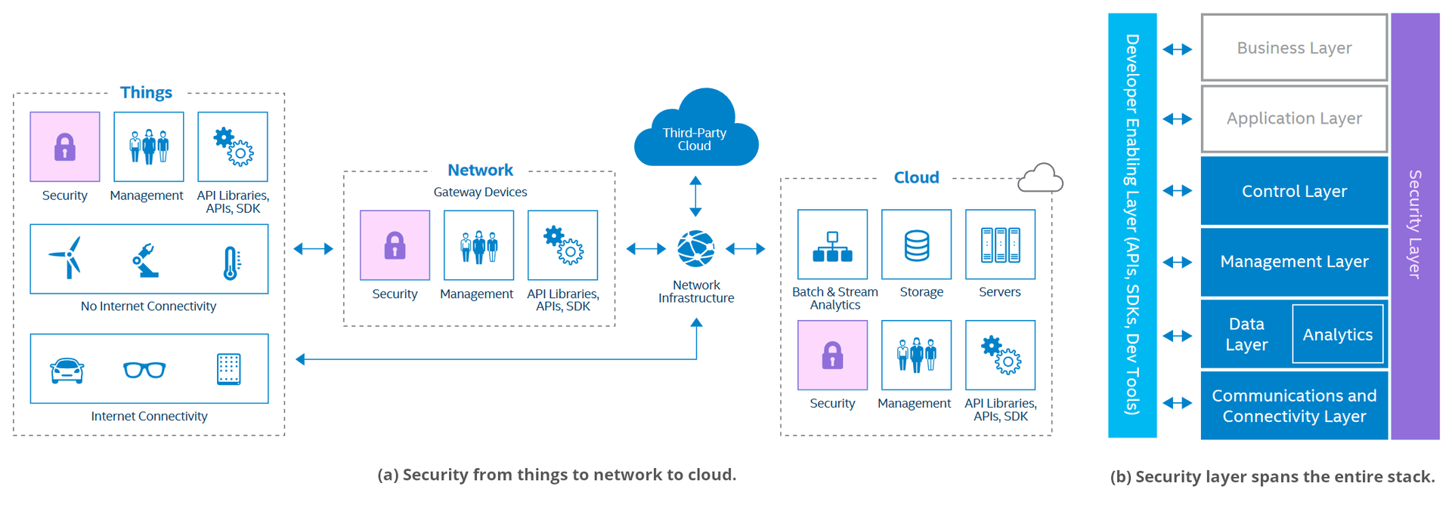

Slide 13



Future Developments
Enhanced Security Solutions
Interoperability and Standards
Edge Computing
5G and Beyond
Energy Efficiency
AI and Machine Learning Integration
Ethical and Regulatory Advances
Integration with Blockchain

Slide 14
Conclusion
1. IoT is poised to transform industries by enabling smarter and more connected systems.
2. Significant challenges remain, including security vulnerabilities, data protection, and privacy issues.
3. The lack of universal standards and difficulties in managing large-scale networks hinder progress.
4. Future advancements in security, AI, edge computing, 5G, and blockchain are crucial for overcoming current challenges.
5. Successfully addressing these challenges will allow IoT to reach its full potential, enhancing innovation and quality of life.

Slide 15



References
Pargaonkar, Shravan. "A Review of Software Quality Models: A Comprehensive Analysis." Journal of Science & Technology 1.1 (2020): 40-53.
Ding, Liang, et al. "Understanding and improving lexical choice in non-autoregressive translation." arXiv preprint arXiv:2012.14583 (2020).
Vyas, Bhuman. "Java in Action: AI for Fraud Detection and Prevention." International Journal of Scientific Research in Computer Science, Engineering and Information Technology (2023): 58-69.
Reddy, Surendranadha Reddy Byrapu, and Surendranadha Reddy. "Large Scale Data Influences Based on Financial Landscape Using Big Data." Tuijin Jishu/Journal of Propulsion Technology 44.4 (2023): 3862-3870.
Singh, Amarjeet, et al. "Improving Business Deliveries using Continuous Integration and Continuous Delivery using Jenkins and an Advanced Version Control System for Microservices-based system." 2022 5th International Conference on Multimedia, Signal Processing and Communication Technologies (IMPACT). IEEE, 2022.
Ding, Liang, Di Wu, and Dacheng Tao. "Improving neural machine translation by bidirectional training." arXiv preprint arXiv:2109.07780 (2021).

Slide 16
Thank You

